Slide 1
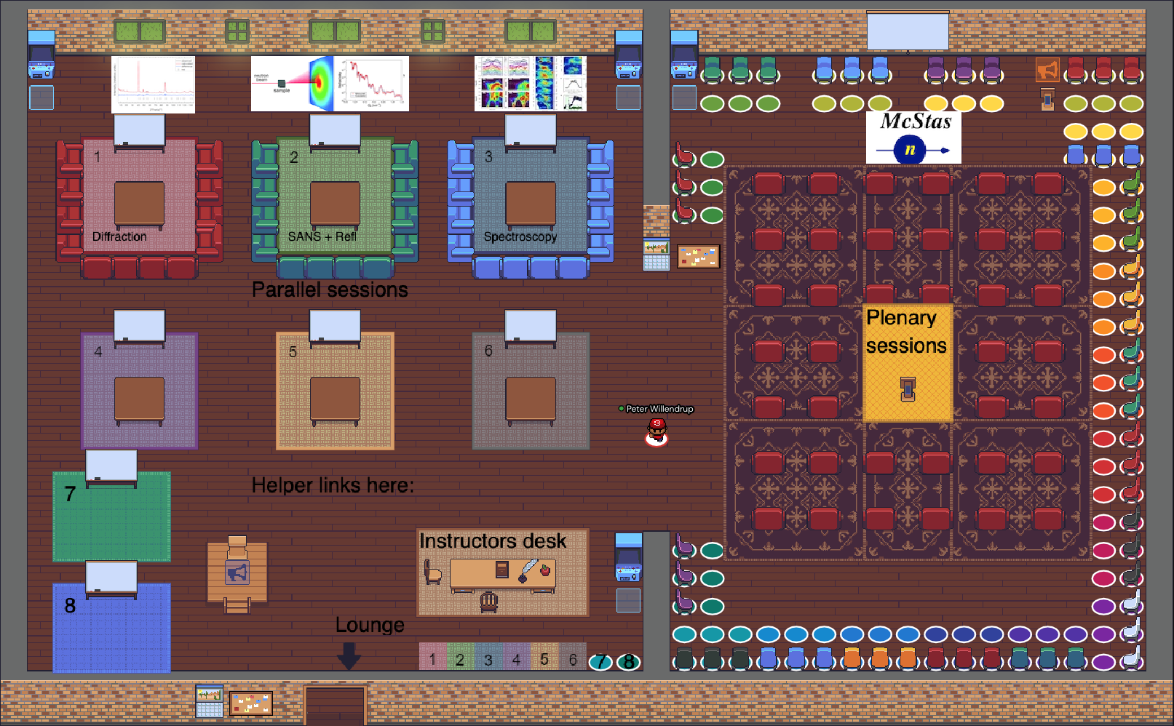
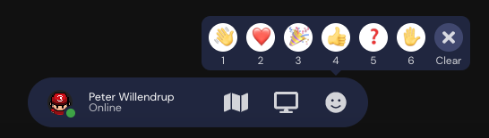
School venue is Gather.town. Main rooms:
You can move your avatar around using the arrow keys
You can interact with objects such as screens or documents using the x key
You can share your screen, react by raising your hand etc. via the panel at the bottom of your screen
In “open areas” you will be able to talk to other participants in your vicinity
Groups of participants can interact in “private areas”
There are also functions to write chat-messages to other users (all or specific), to locate another user, to follow another user. The audio/video functionality is similar to zoom / teams, you may share your screen etc.

Slide 2
School venue is Gather.town. Lecture hall:
For attending a plenary presentation, please place your avatar in this area
Questions to the speaker can be asked from the central area without chairs
When solving exercises in groups of two people, please use the pairs of red chairs arranged at the edge of the room
If you need attention, please raise your hand via the panel at the bottom of your screen:

Slide 3
School venue is Gather.town. Lecture hall:
This is what lectures will look like: The presenter is sharing his screen, but will also be able to see if you raise your hand

Slide 4
School venue is Gather.town. Breakout sessions:
In the breakout-sessions we will divide ourselves in the three “private areas” marked 1 2 and 3, depending on topic.
These and other private areas can be used when working together as smaller teams, along with the pairs of red chairs in the lecture hall.
There are whiteboards in these areas that can be used for collaboration.
The blue arcade-machines can be used for access to school material, IDaaAS etc.

Slide 5
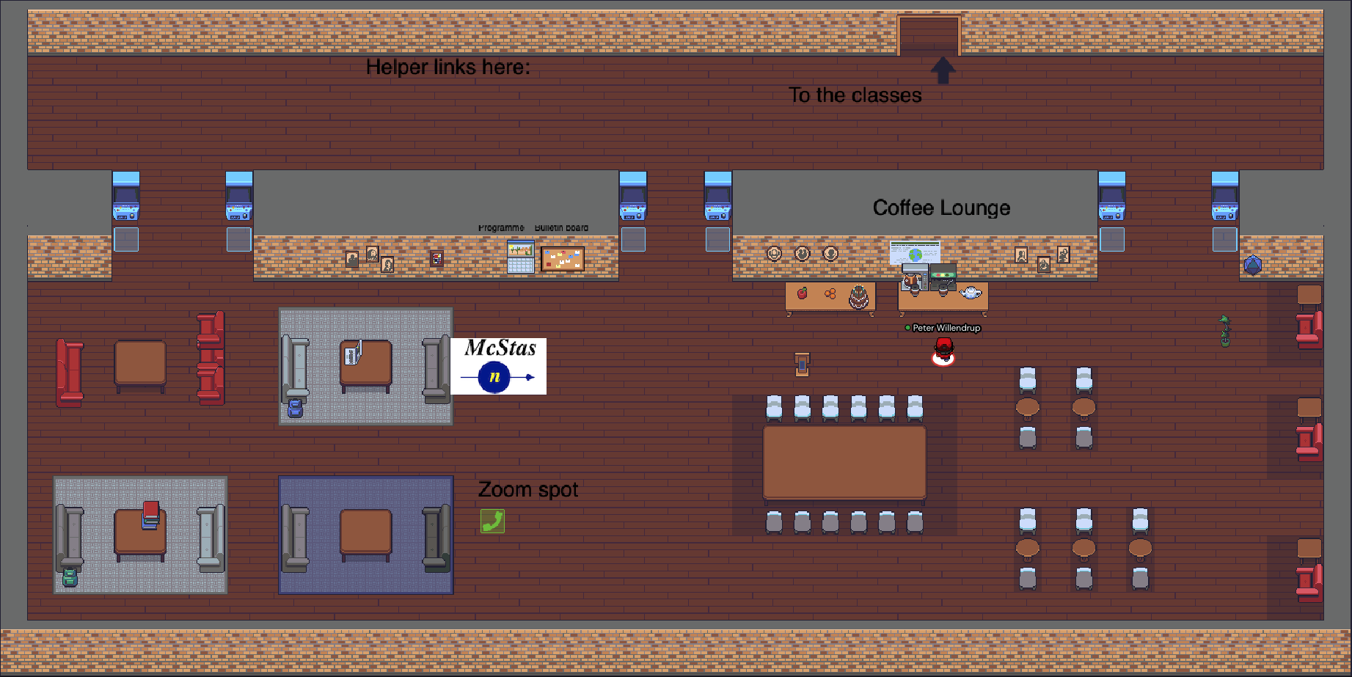
School venue is Gather.town. Lounge area:
There is an open lounge-oriented space outside the main rooms, can be used for casual chats. It further contains an overview of the programme and a bulletin board, plus a number of information-“arcade-machines”
The Zoom spot is intended as a fallback-solution only

